Slide 1
Data Exploration (WDBC)
Robert Oliver | Oliver Tipton

Slide 2
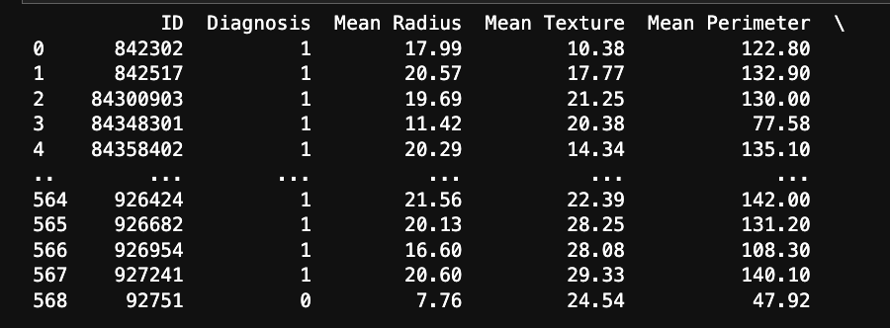
Reading in the Data
Utilized read_csv() to read in and assign column names
Helpful for exploring data, especially understanding the scale of each value
Mapped malignant to 1 and benign to 0 for data visualization and usage purposes
Dropped ID column

Slide 3
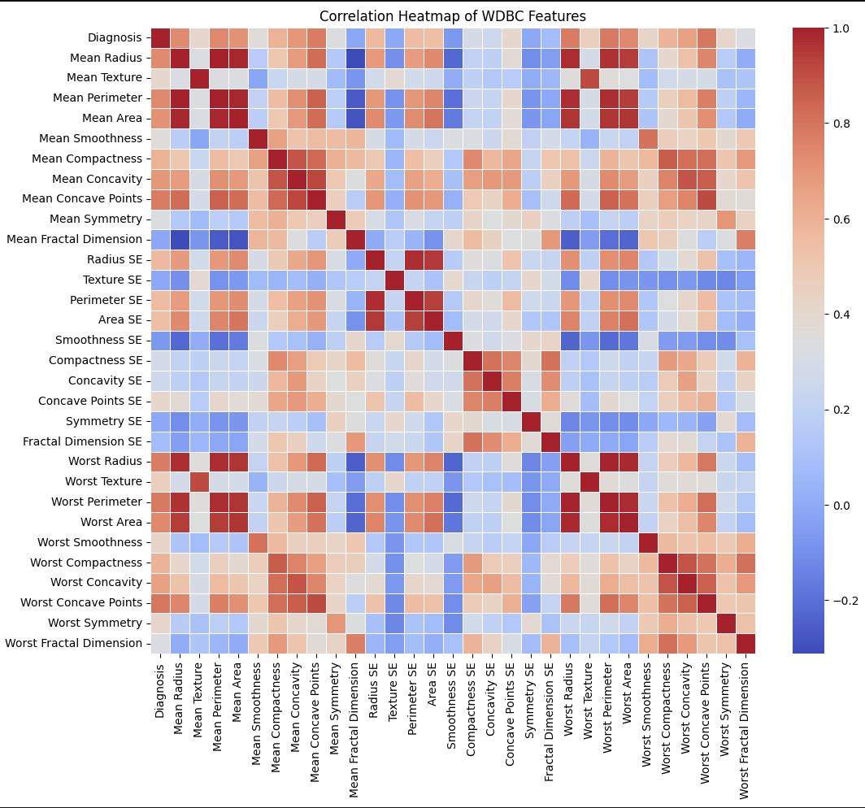
Correlation Heatmap

Slide 4
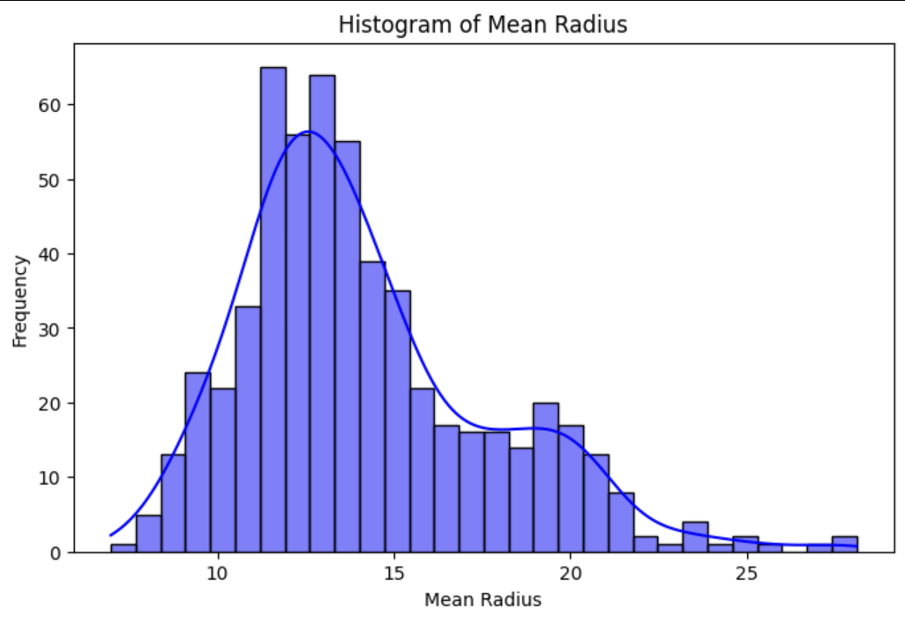
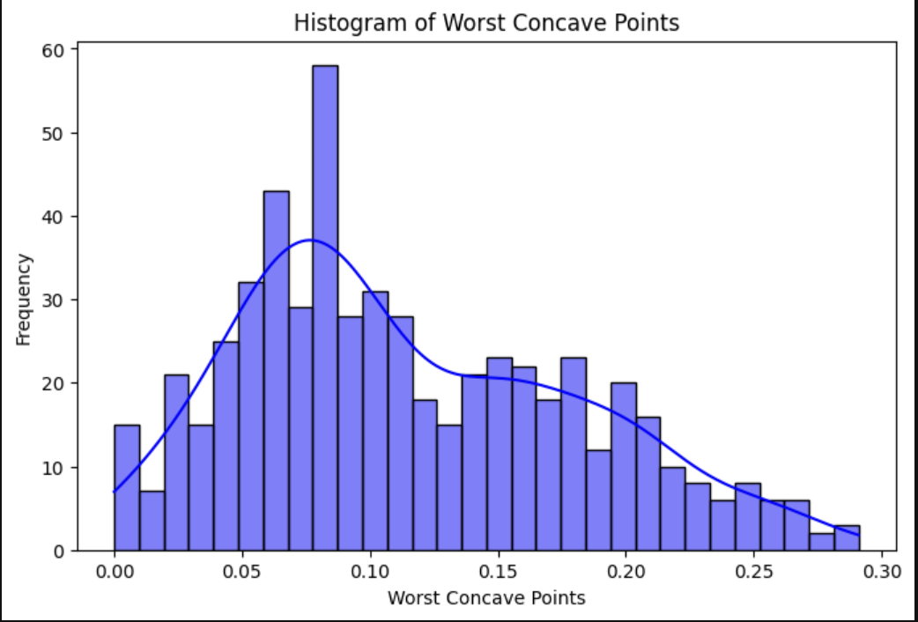
Distribution Histograms for Highly Correlated Parameters

Slide 5
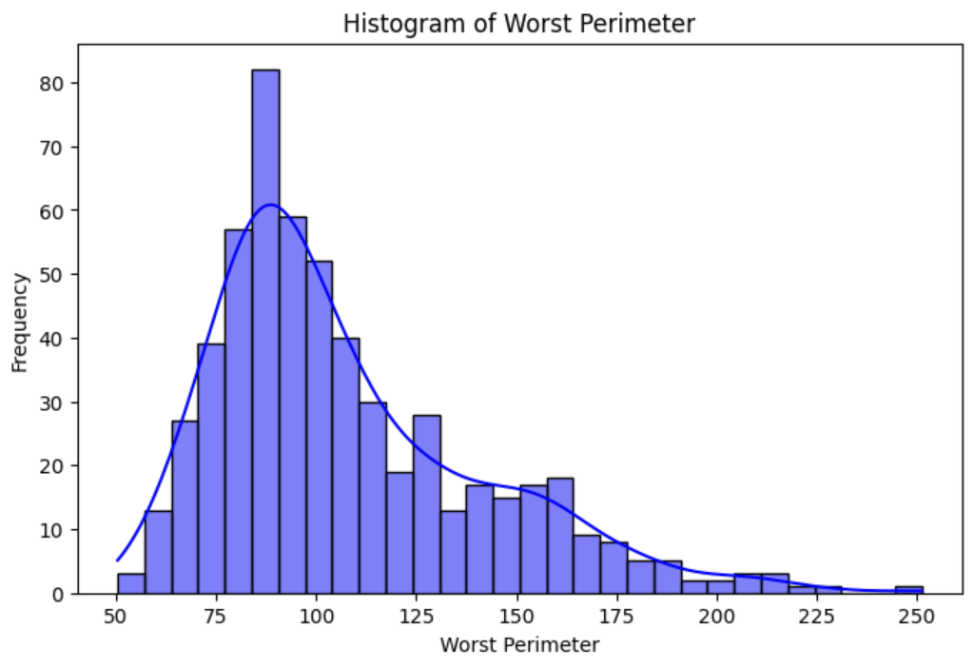
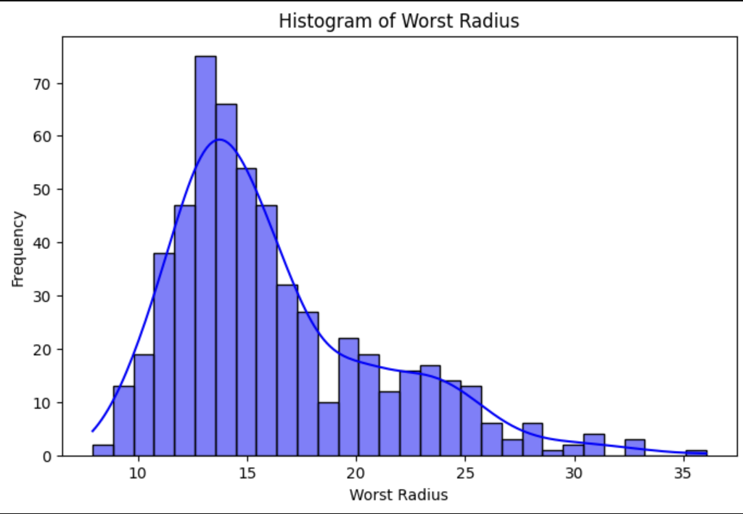
Distribution Histograms for Highly Correlated Parameters

Slide 6
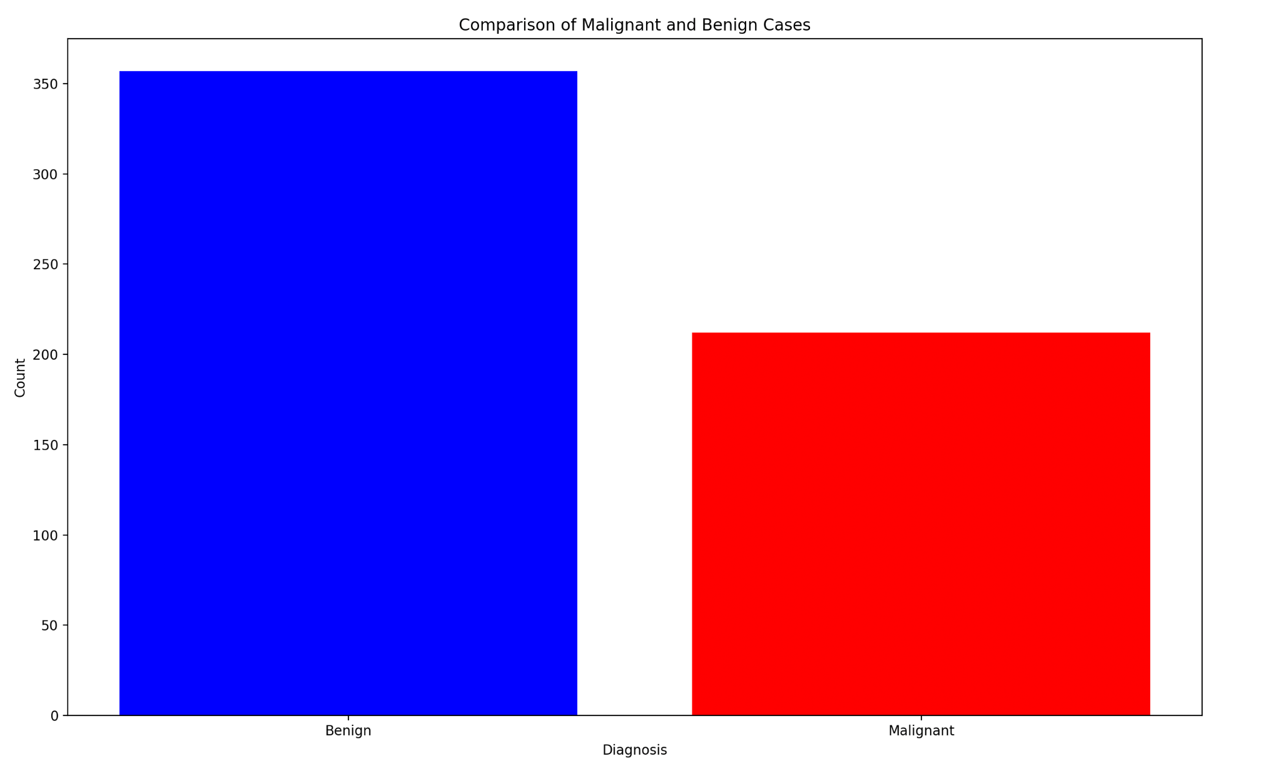
Benign vs Malignant
Benign - non-cancerous, does not spread to other regions of the body:
B in the data set
Malignant - cancerous, has the potential to spread to other regions of the body:
M in the data set

Slide 7
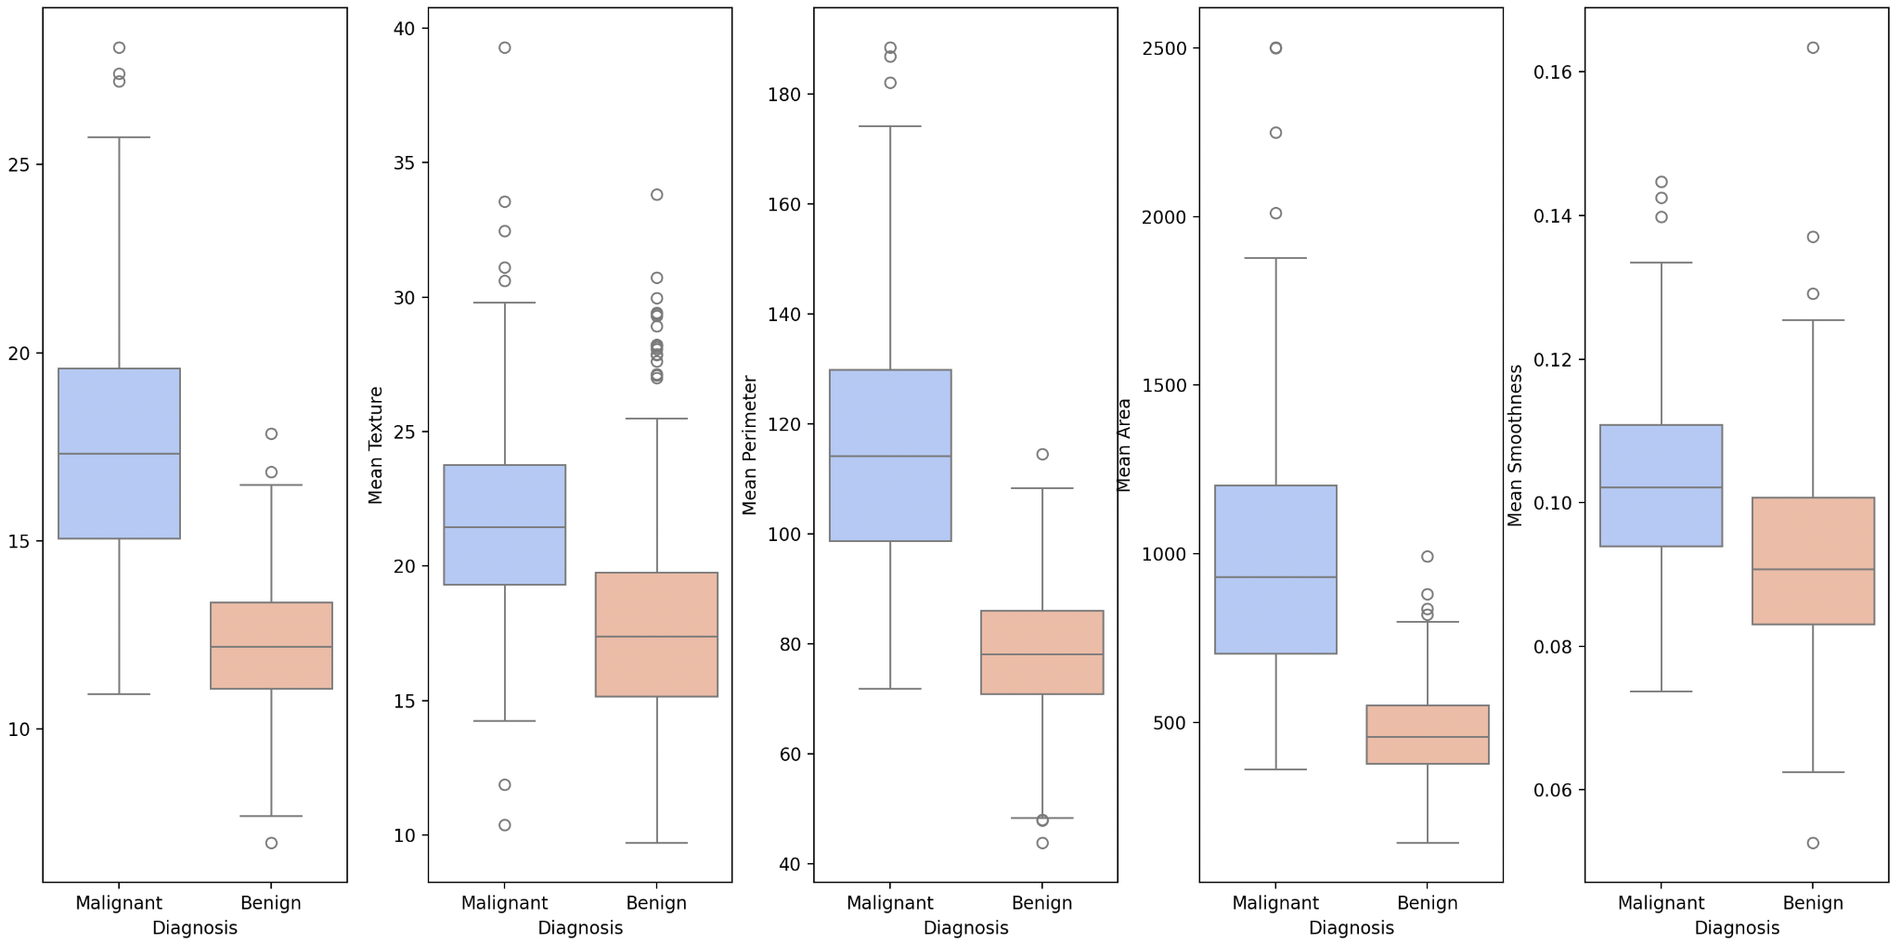
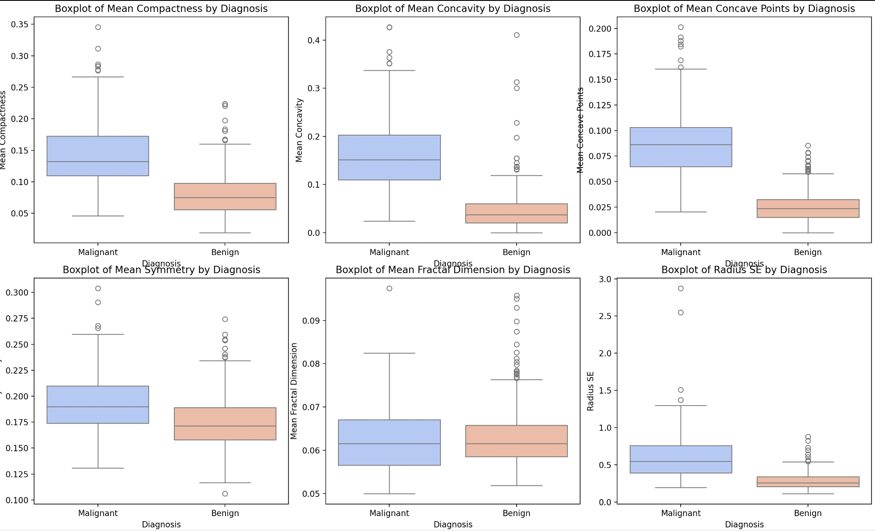

Slide 8
Cleanliness of the Data
The Data is clean and distinct, there are no duplicate values in the data
The Data also contains 0 null values
Only primarily issue for pre-processing is handling outliers and possibly scaling the data.

Slide 9

Model
Feature selection:
  Utilizing Correlation Heatmap
  Dropping Darker blues and lights to remove less correlated data
Loss Function:
  Binary Cross Entropy - better for binary prediction models and training purposes
Python Libraries:
  PyTorch
  Pandas
  Matplotlib
Activation Functions:
  Inputs: ReLu - Modeling Cancer is nonlinear
  Hidden Layers (3) - ReLu
  Output: Sigmoid - Binary Classification

Slide 10
Ethics
Possibly more data needed and testing, as this is NOT a cohesive diagnosis method for cancerous cells
Trained on the data available, and accurate on the data available

